Slide 1

CE101 Engineering Drawing Lec4: Projection of Points, Lines and Traces
Indian Institute of Technology Guwahati
Notes:
Today we will discuss about the Modeling and

Slide 2
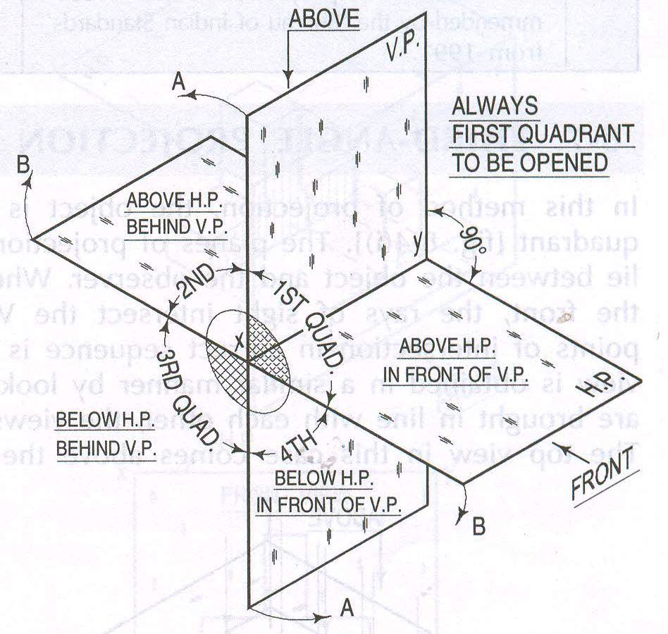

Slide 3
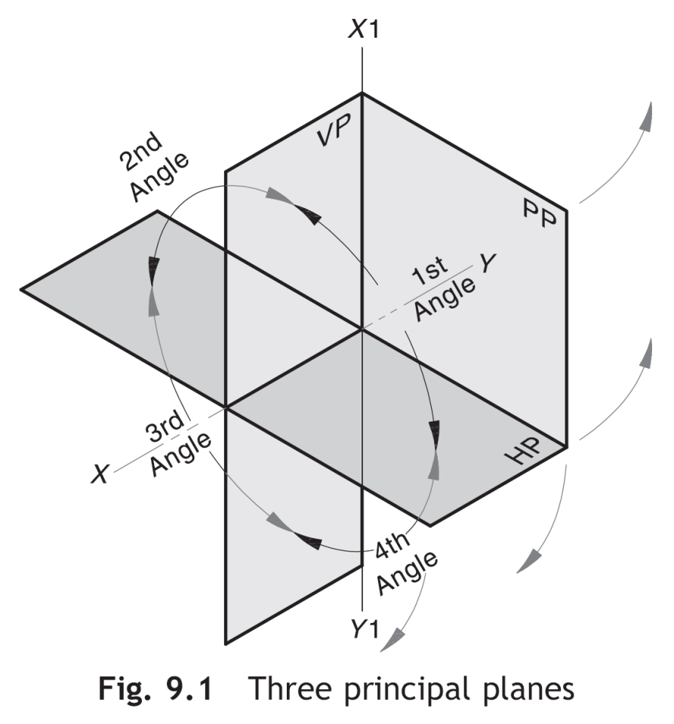
Recap: Quadrant
Four quadrants
The position of an object in space can be determined by these quadrants
RPs: HP, VP and PP
Horizontal reference line (XY): The line at which the HP and the VP meet.
Profile reference line (X1Y1): The line at which the HP (or the VP) and the PP meet.
After the views are obtained:
HP is rotated about XY in the clockwise direction to bring it in plane with the VP.
PP is rotated about X1Y1 away from the object.

Slide 4
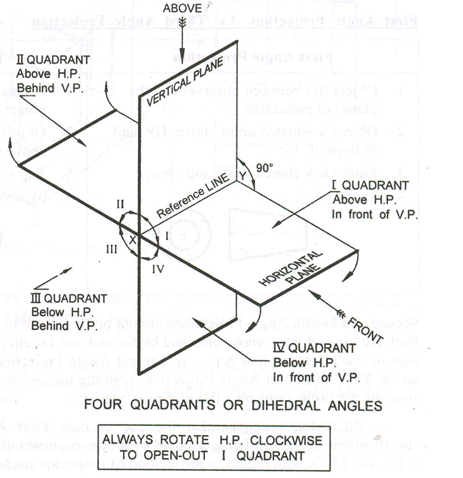

Slide 5
NOTATIONS
Following notations should be followed while naming
Different views in orthographic projections.
OBJECT POINT A LINE AB
IT’S TOP VIEW a a b
IT’S FRONT VIEW a´ a´ b´
IT’S SIDE VIEW a´´ a´´ b´´
Same system of notations should be followed
incase numbers, like 1, 2, 3 – are used.
TERMS ‘ABOVE’ & ‘BELOW’ WITH RESPECT TO H.P.
AND TERMS ‘INFRONT’ & ‘BEHIND’ WITH RESPECT TO V.P.

Slide 6
2nd Quadrant
VP
2nd Quad.
1ST Quad.
F.V.
1st Quadrant
Y
Observer
X Y
HP
X
3rdQuadrant
Observer
3rd Quad.
4th Quad.
4th Quadrant
This quadrant pattern, if observed along x-y line (in red arrow direction) will exactly appear as shown on right side and hence it is further used to understand illustration properly.

Slide 7
POINT A IN
2ND QUADRANT
VP
POINT A IN
1ST QUADRANT
VP
a´
A
Point A is
placed In
different
quadrants
and it’s FV & TV
are brought in
same plane for
Observer to see
clearly.
FV is visible as
it is a view on
VP. But as TV is
is a view on HP,
it is rotated
90⁰,
in clockwise
direction. The
front part of
HP comes below
XY line and the
part behind VP
comes above.
A
a´
a
HP
OBSERVER
HP
OBSERVER
a
a
HP
HP
OBSERVER
OBSERVER
a
a´
A
a´
POINT A IN
3RD QUADRANT
A
POINT A IN
4TH QUADRANT
VP
VP

Slide 8
PROJECTIONS OF A POINT IN FIRST QUADRANT
POINT A ABOVE HP
& INFRONT OF VP
POINT A ABOVE HP
& IN VP
POINT A IN HP
& INFRONT OF VP
For TV
For TV
PICTORIAL
PRESENTATION
PICTORIAL
PRESENTATION
For TV
a´
a´
A
A
For FV
Y
Y
Y
For FV
a
a´
X
a
a
X
X
A
For FV
ORTHOGRAPHIC PROJECTIONS
OF ALL ABOVE CASES.
FV above XY,
TV below XY.
FV above XY,
TV on XY.
FV on XY,
TV below XY.
VP
VP
VP
a´
a´
X
Y
X
Y
X
a´
Y
a
a
a
HP
HP
HP

Slide 9
Notation System
The top view of a point P shall be indicated by p
The FV of a point P shall be indicated by p´
The SV of a point P shall be indicated by p´´

Slide 10
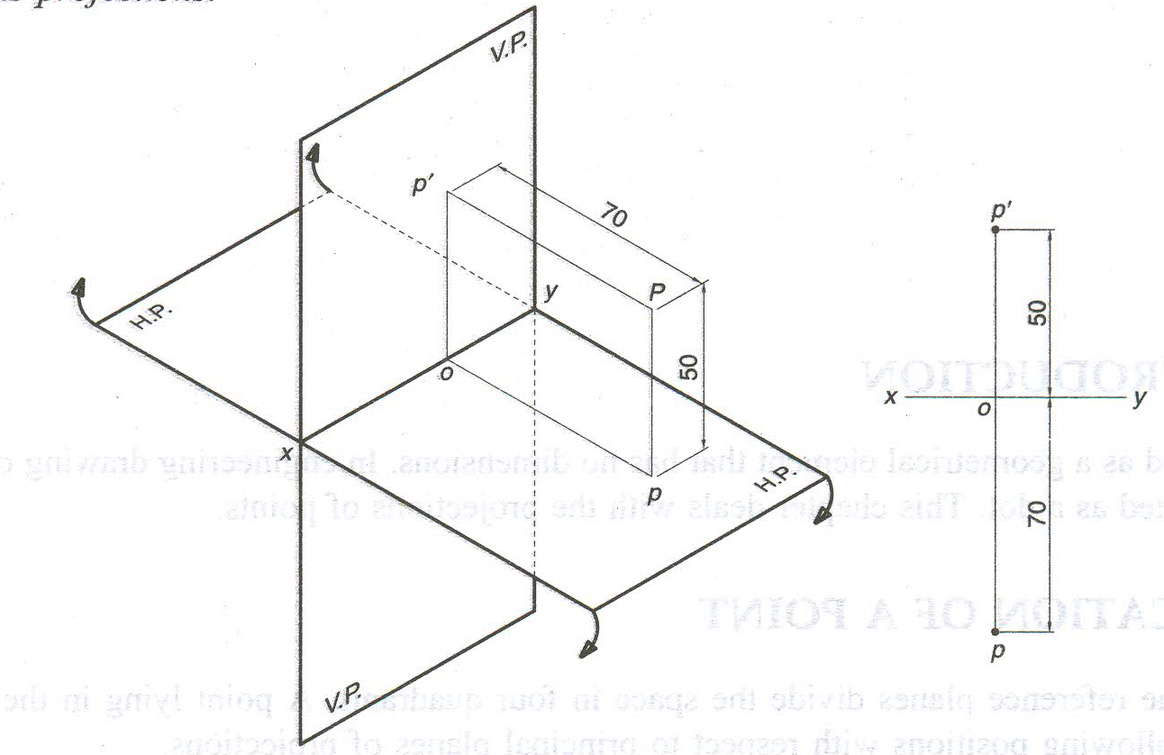
Point in the First Quadrant
Point is above HP and in front of VP
p´
FV
50
x
y
o
70
p
TV
Check notation system

Slide 11
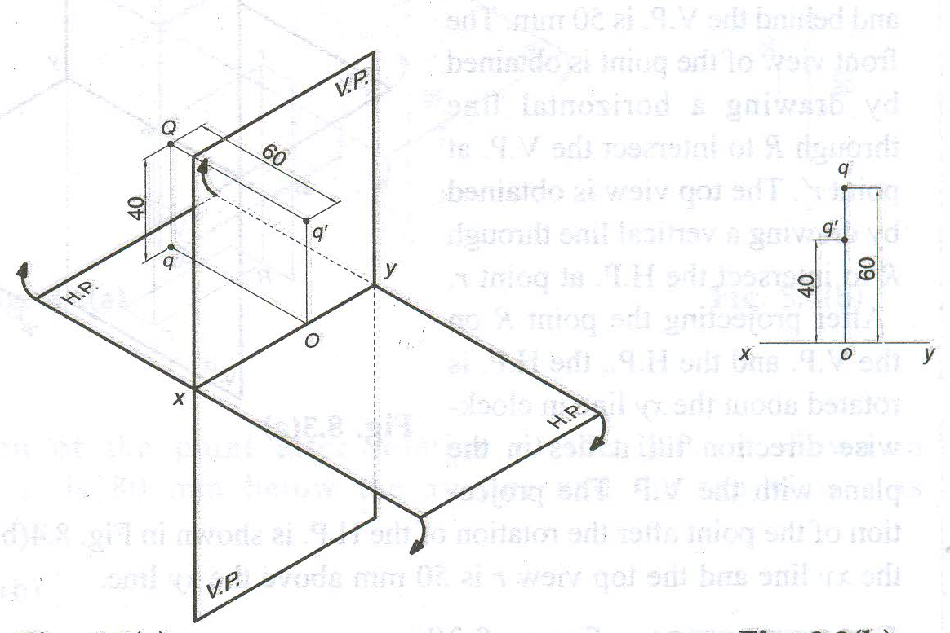
Point in the Second Quadrant
Point is above HP and behind VP
Check notation system

Slide 12
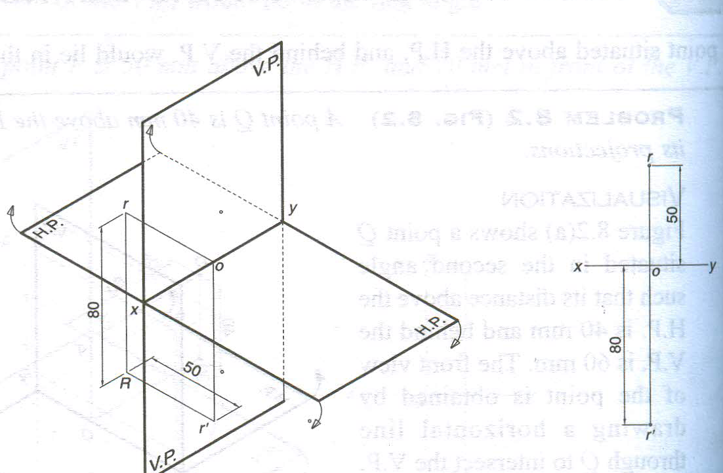
Point in the Third Quadrant
Point is below HP and behind VP

Slide 13
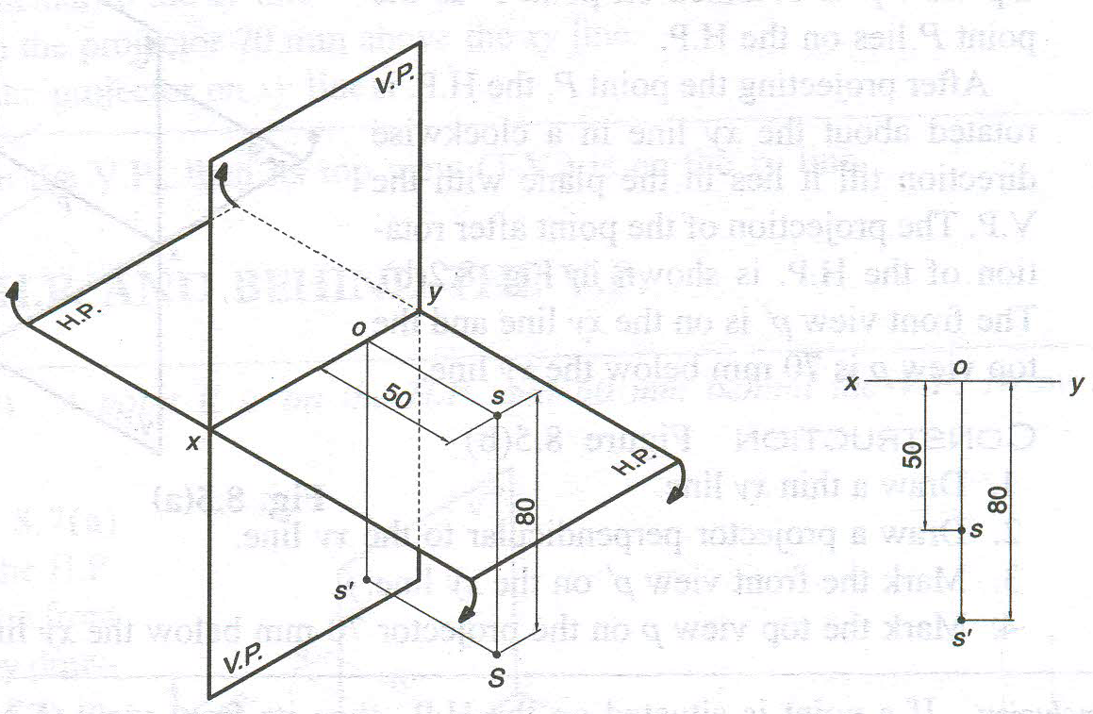
Point in the Fourth Quadrant
Point is below HP and in front of VP

Slide 14
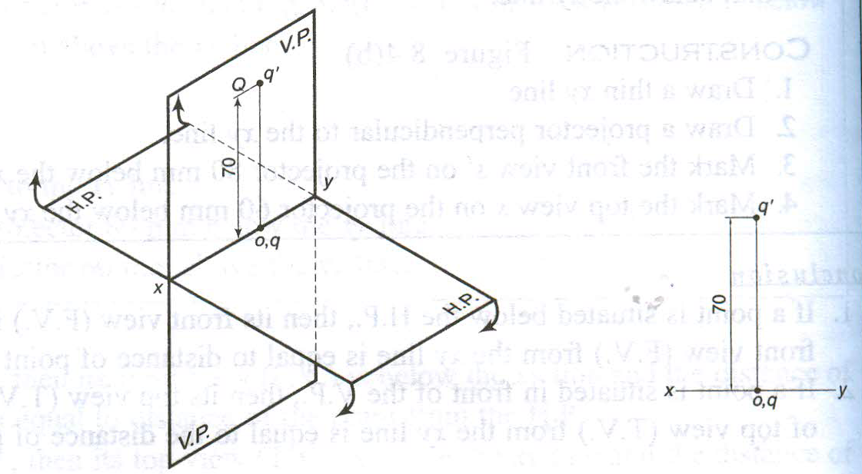
Point is on VP and Above HP

Slide 15
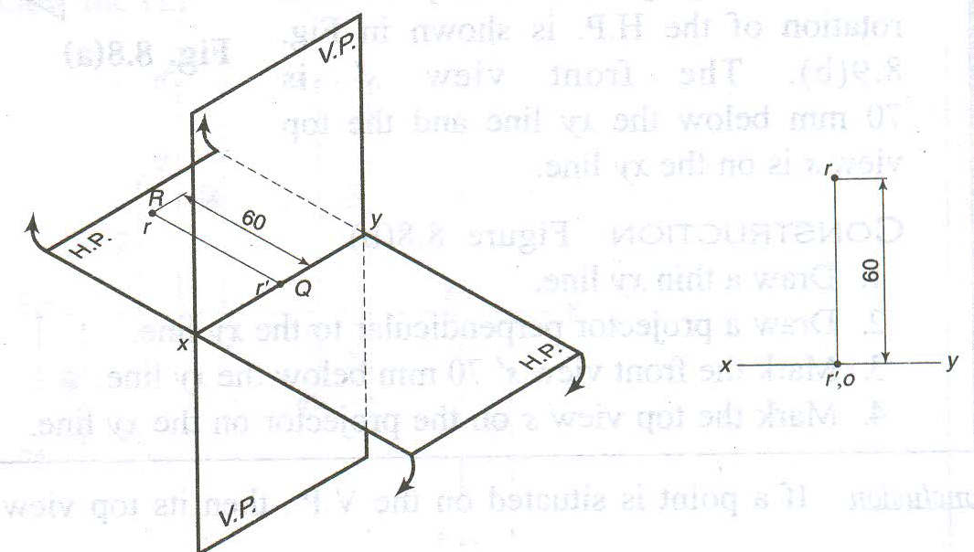
Point is on HP and Behind VP

Slide 16
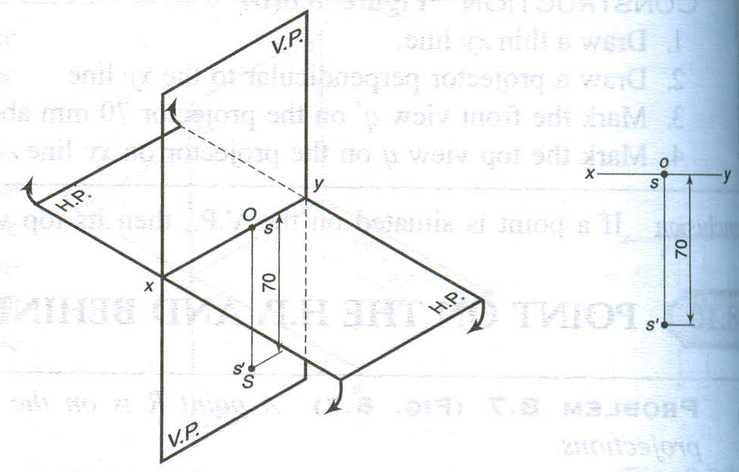
Point is on VP and Below HP

Slide 17
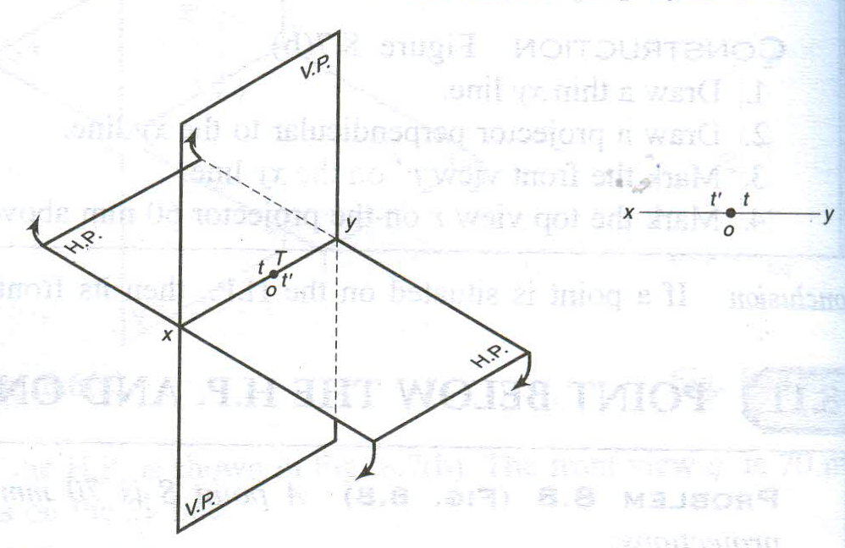
Point in Both RPs

Slide 18
EXAMPLE PROBLEMS ON POINTS
PROBLEM:
A point A is 20 mm above HP and 30 mm in front of VP. Draw its projections
Solution steps:
Draw reference line XY.
Mark a point a´ at a distance of 20 mm above XY.
Through this point draw a perpendicular line to XY and mark the top view a at a distance of 30 mm below XY.
VP
Orthographic projection
30
A
a´
a´
20
Y
HP
20
X
Y
a
X
30
a
a

Slide 19
PROBLEM:
Draw the projections of the following points on the same ground line.
Point A, 20 mm above HP, 25 mm behind VP;
(ii) Point B, 25 mm below HP, 20 mm behind VP;
Point C, 20 mm below HP, 30 mm in front of VP;
(iv) Point D, 20 mm above HP, 25 mm in front of VP;
(v) Point E, on HP, 25 mm behind VP;
(vi) Point F, on VP, 30 mm above HP;
Solution:
f´
e
a
b
d
a´
30
25
20
25
20
20
X
e´
f
Y
20
25
30
25
c´
b´
d´
c

Slide 20
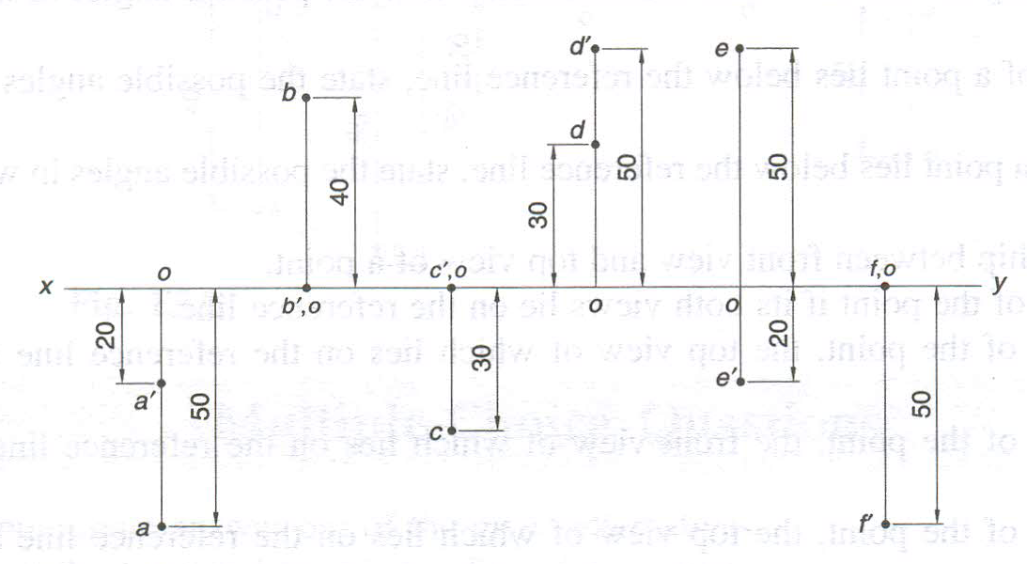
Mind Storming: Example 1
Above HP and behind VP
In HP and behind VP
In VP and below HP
Below HP and behind VP
In HP and in front of VP
Below HP and in front of VP

Slide 21
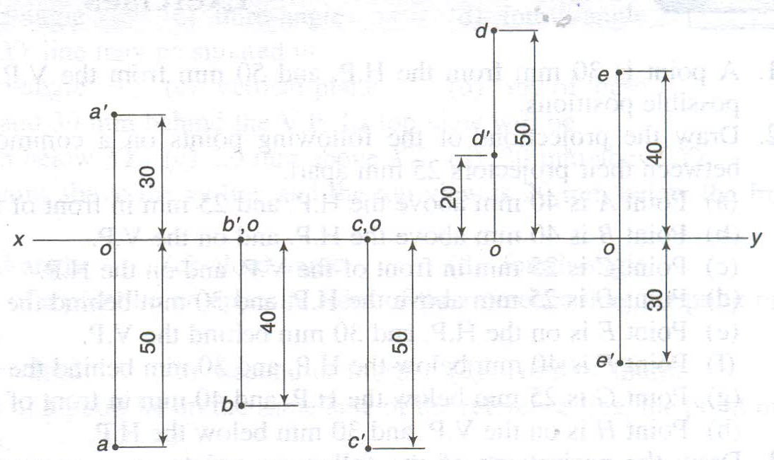
Mind Storming: Example 2
Exercise for students

Slide 22
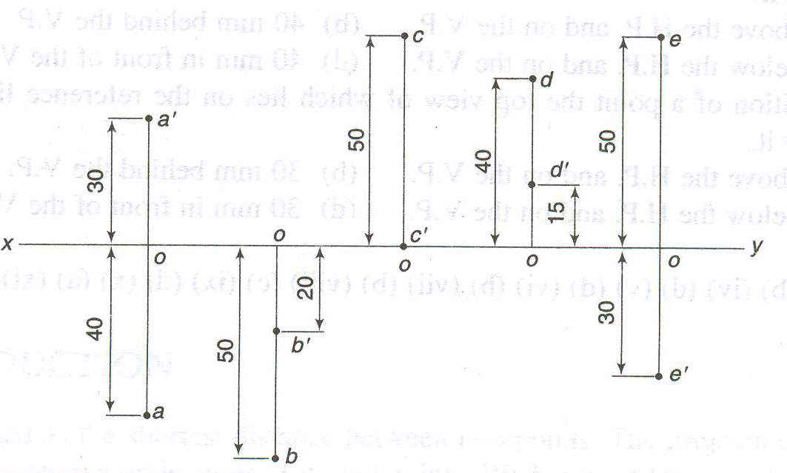
Mind Storming: Example 3
Exercise for students

Slide 23
Projection of Lines

Slide 24
PROJECTIONS OF LINES
A straight line is the shortest distance between any two points in space.
A line represents the locus of a point moving along a fixed path in space.
As a line consists of a number of points, its projections are drawn by joining the projections of any two points on the line (preferably the end points) or on the extension of the line.
Positions Of Straight Lines
Line parallel to both the RPs
Line away from both the RPs
Line in the HP and away from the VP
Line in the VP and away from the HP
Line contained by both the RPs

Slide 25
PROJECTIONS OF LINES
Line perpendicular to either of the RPs
Line perpendicular to the HP and away from the VP
Line perpendicular to the HP and in the VP
Line perpendicular to the VP and away from the HP
Line perpendicular to the VP and in the HP
Line inclined to one RP and parallel to the other
Line inclined to the HP, parallel to the VP and away from the VP
Line inclined to the HP and in the VP
Line inclined to the VP, parallel to the HP and away from the HP
Line inclined to the VP and in the HP
Line inclined to both the RPs (Oblique line)
h_{a} less than h_{b} and d_{a} less than d_{b}
h_{a} less than h_{b} and d_{a} greater than d_{b}
h_{a} greater than h_{b} and d_{a} less than d_{b}
h_{a} greater than h_{b} and d_{a} greater than d_{b}
Line parallel to (or contained by) the PP
Line parallel to the PP and the HP
Line parallel to the PP and the VP
Line parallel to the PP and inclined to the HP and the VP

Slide 26
Terms used in Projections of Lines
True Length (TL): The actual length of a line is called its true length.
Plan Length (PL) or Top View Length: The apparent length of a line seen in TV is called the plan length or top view length.
Elevation Length (EL) or Front View Length: The apparent length of a line seen in FV is called the elevation length or front view length.
Side View Length (SVL): The apparent length of a line seen in SV is called its side view length.
Inclination with the HP (θ): It is the true angle that a line makes with its projection on the HP. It is indicated by θ.
Inclination with the VP (Φ): It is the true angle that a line makes with its projection on the VP. It is indicated by Φ.

Slide 27
Terms used in Projections of Lines
Apparent Angle with the HP (α): It is the angle which an oblique line seems to be making with the HP in FV. It is the angle between FV and XY. It is indicated by α.
Apparent Angle with the VP (β): It is the angle which an oblique line seems to be making with the VP in TV. It is the angle between TV and XY. It is indicated by β.
Horizontal Trace (HT): The point of intersection of the line (or its extension) with the HP is called the horizontal trace of the line.
Vertical Trace (VT): The point of intersection of the line (or its extension) with the VP is called the vertical trace of the line.
Point View of the Line: The view of a line seen as a point (i.e., when the views of two ends coincide) is called the point view.

Slide 28
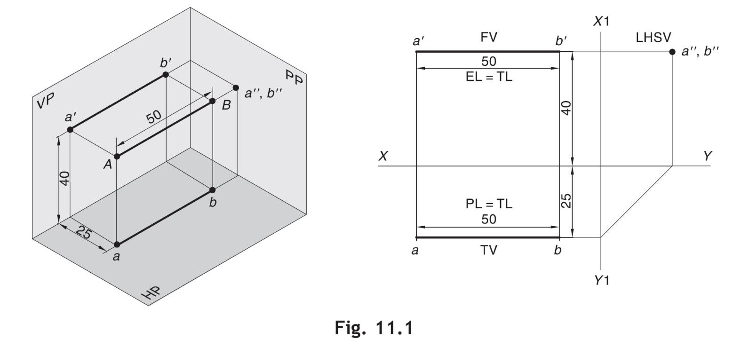
Line Parallel To Both The RPs
Draw the projections of a line AB that is 50 mm long and is parallel to both the HP and the VP. The line is 40 mm above the HP and 25 mm in front of the VP.
FV and TV, will be parallel to XY and both will show the TL (= 50 mm).
If a line is parallel to both the HP and the VP, it must be perpendicular to the PP. Therefore, point A and point B will coincide in SV of the line. Hence, the LHSV is a point view.
Quadrant 1

Slide 29
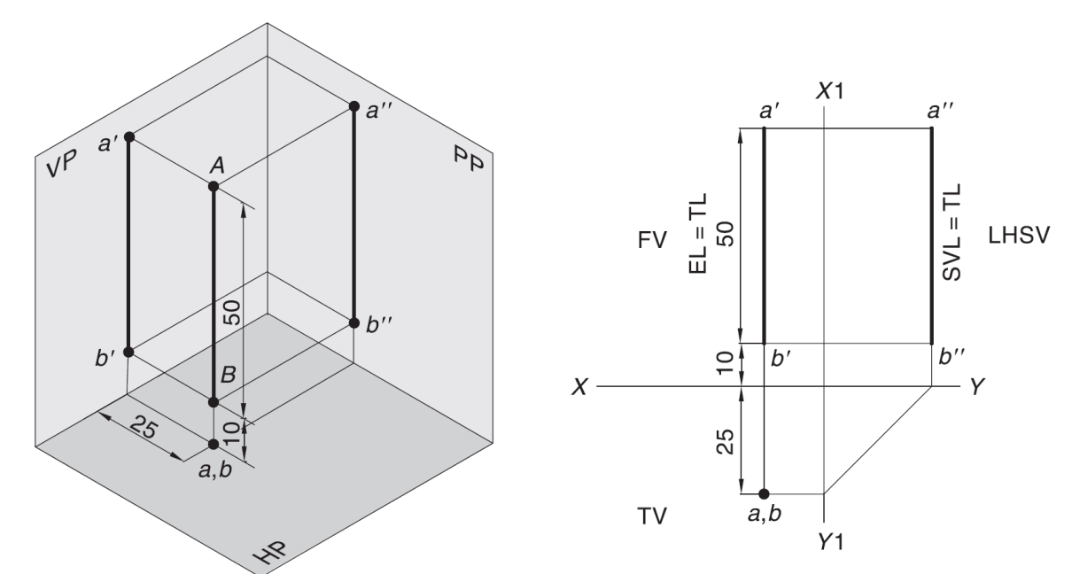
Line Perpendicular to Either of The RPs
A line AB, 50 mm long, is perpendicular to the HP and 25 mm in front of the VP. Draw its projections if the end nearest to the HP is 10 mm above the HP.
If a line is perpendicular to the HP, it will automatically be parallel to the VP and PP. Hence, its
FV will show the TL.
TV will be a point view, wherever two (or more) points overlap, the visible point should be marked first.
TV is marked as a, b. It means that a is visible and b is hidden. The hidden point(s) may be enclosed in parenthesis ( ), e.g., a( b).

Slide 30
Line Inclined to One RP and Parallel to Other
A line AB, 50 mm long, is inclined to the HP at 30° and parallel to the VP. The end nearest to the HP is 40 mm above it and 25 mm in front of the VP. Draw the projections.
b’
Nearest end a-a’
θ
a’
b1’
a’-b1’ = a-b=50
Assuming line is
Parallel to both HP
and VP
40
X
Y
25
Arc: center a’ and
Radius = a’-b1’
a
b
b1

Slide 31
For TV
Orthographic Pattern
(Pictorial Presentation)
V.P.
a´
Note:
FV is a vertical line
Showing True Length
&
TV is a point.
a´
1.
V.P.
A
FV
FV
A line
perpendicular
to HP
&
parallel to VP
b´
b´
Y
X
Y
B
For FV
TV
a (b)
X
TV
a (b)
H.P.
Orthographic Pattern
(Pictorial Presentation)
Note:
FV & TV both are
// to XY
&
both show T. L.
V.P.
For TV
2.
a´
FV
b´
A line
// to HP
&
// to VP
V.P.
F.V.
b´
B
a´
A
Y
X
Y
For FV
b
a
b
T.V.
TV
X
a
H.P.

Slide 32
FV inclined to XY TV parallel to XY
V.P.
3.
V.P.
b´
b´
A line inclined to HP
and
parallel to VP
(Pictorial presentation)
F.V.
B
F.V.
a´
θ
θ
Y
a´
θ
X
Y
A
b
a
T.V.
b
X
T.V.
a
H.P.
Orthographic Projections
TV inclined to XY FV parallel to XY
V.P.
4.
V.P.
FV
A line inclined to VP
and
parallel to HP
(Pictorial presentation)
F.V.
b´
a´
b´
a´
A
Ø
B
X
Y
a
Ø
Ø
b
TV
a
T.V.
b
H.P.

Slide 33
Parallel to VP and inclined to HP
PROBLEM:
A straight line AB of 40 mm length has one of its ends A, at 10 mm from the HP and 15 mm from the VP. Draw the projections of the line if it is parallel to the VP and inclined at 30° to the HP. Assume the line to be located in each of the four quadrants by turns.
b´
40
b´
a´
30°
10
a
30°
b
X
Y
15
15
a´
10
a
( Quadrant 1)
b
X
(Quadrant 2)
Y
a
b
X
Y
15
10
a´
15
X
Y
10
a
b
30°
a´
30°
(Quadrant 4)
b´
(Quadrant 3)
b´

Slide 34
For TV
For TV
5.
A Line inclined to both
HP and VP
(Pictorial presentation)
b´
b´
V.P.
V.P.
B
F.V.
B
F.V.
α
α
Y
Y
On removal of object
i.e. Line AB
FV as a image on VP.
TV as a image on HP,
a´
a´
For FV
For FV
A
A
β
X
β
X
a
T.V.
b
a
T.V.
b
V.P.
b´
FV
a´
α
Orthographic Projections
FV is seen on VP clearly.
To see TV clearly, HP is rotated 90⁰ downwards,
Hence it comes below XY.
X
Y
Note:-
Both FV & TV are inclined to XY.
(No view is parallel to XY)
Both FV & TV are reduced lengths
(No view shows True Length)
a
β
TV
H.P.
b

Slide 35
Orthographic Projections
Means FV & TV of Line AB
are shown below, with their apparent inclinations α & β
Note the procedure
When FV & TV known,
How to find True Length.
(Views are rotated to determine
True Length & it’s inclinations
with HP & VP).
Note the procedure
When True Length is known,
How to locate FV & TV.
(Component a-1 of TL is drawn
which is further rotated
to determine FV)
V.P.
V.P.
V.P.
b´
b´
b₁´
b´
b₁´
FV
FV
Fv
TL
a´
α
TL
a´
θ
α
1´
a´
θ
X
X
Y
Y
X
Y
1
a
β
a
β
b₂
a
Ø
TV
β
TV
TV
TV
TL
H.P.
b
H.P.
b
H.P.
b
b₁
In this sketch, TV is rotated
and made // to XY line.
Hence it’s corresponding
FV, a’ b₁’ is showing
True Length
&
True Inclination with HP.
Here a -1 is component
of TL ab₁ gives length of FV.
Hence it is brought upto
Locus of a’ and further rotated
to get point b’. a’ b’ will be FV.
Similarly drawing component
of other TL (a’ b₁‘) TV can be drawn.
Here TV (ab) is not // to XY line
Hence it’s corresponding FV
a’ b’ is not showing
True Length &
True Inclination with HP.

Slide 36
1) True Length (TL) – a’ b₁’ & a b₁
Diagram showing graphical relations
among all important parameters of this topic.
2) Angle of TL with HP -
θ
TEN important
parameters
to be remembered
with notations
used here onward
3) Angle of TL with VP –
Ø
4) Angle of FV with XY –
α
β
V.P.
5) Angle of TV with XY –
Distance between
End Projectors.
6) LFV (length of FV) – Component (a-1)
b´
b₁´
7) LTV (length of TV) – Component (a’-1’)
8) Position of A- Distances of a & a’ from XY
FV
9) Position of B- Distances of b & b’ from XY
TL
α
10) Distance between End Projectors
a´
θ
1´
LTV
NOTE
θ
α
Construct with a’
X
Y
&
a
LFV
1
Ø
&
β
Construct with a
Ø
b’ & b₁’ on same locus.
β
b & b₁ on same locus.
TV
TL
Also remember
H.P.
b
b₁
True Length is never rotated. It’s horizontal component is drawn & it is further rotated to locate view.
Views are always rotated, made horizontal & further extended to locate TL, θ & Ø

Slide 37
INCLINED TO HP & VP
PROBLEM 7:
Line AB is 75 mm long and it is 30⁰ & 40⁰ inclined to HP & VP respectively. End A is 12mm above HP and 10 mm in front of VP. Draw projections. Line is in 1st quadrant.
b´
b´₁
Solution steps:
1) Draw XY line and one projector.
2) Locate a´ 12mm above XY line
& a 10mm below XY line.
3) Take 30⁰ angle from a´ & 40⁰ from a and mark TL, i.e., 75mm on both lines. Name those points b₁´ and b respectively.
4) Draw horizontal component of TL a b₁ from point b₁ and name it 1. (the length a-1 gives length of FV as we have seen already)
5) Extend it up to locus of a and rotating a’ as center locate b´ as shown. Join a´ b´ as FV.
6) From b´ drop a projector downward & get point b. Join a & b, i.e., TV.
FV
TL
θ
a´
X
Y
a
LFV
1
Ø
TV
TL
b
b₁

Slide 38
FINDING INCLINATION WITH HP
PROBLEM 8:
Line AB 75mm long makes 45⁰ inclination with VP while it’s FV makes 55⁰. End A is 10 mm above HP and 15 mm in front of VP. If line is in 1st quadrant draw it’s projections and find it’s inclination with HP.
Solution Steps:-
1.Draw xy line.
2.Draw one projector for a’ & a
3.Locate a´ 10mm above XY & a 15 mm below XY.
4.Draw a line 45⁰ inclined to XY from point a and cut TL 75 mm on it and name that point b_{1.}
5.Draw locus from point b_{1.}
6.Take 55⁰ angle from a´ for FV above XY line.
7.Draw a vertical line from b₁ up to locus of a and name it 1. It is horizontal component of
TL & is LFV.
8.Continue it to locus of a´ and rotate upward up to the line of FV and name it b´. This a´ b´ line is FV.
9. Drop a projector from b´ on locus from point b₁ and name intersecting point b. Line ab is TV of line ab.
10.Draw locus from b´ and with TL distance cut point b₁´
11.Join a´ b₁´ as TL and measure it’s angle α at a´. It will be true angle of line with HP.
b´
b´ ₁
LOCUS OF b₁´
FV
TL
55⁰
α
a´
X
Y
a
LFV
1
45⁰
TV
TL
LOCUS OF b₁
b
b₁

Slide 39
FINDING TL AND INCLINATIONS
PROBLEM 9: FV of line AB is 50⁰ inclined to XY and measures 55 mm long while it’s TV is 60⁰ inclined to XY line. If end A is 10 mm above HP and 15 mm in front of VP, draw it’s projections, find TL, inclinations of line with HP & VP.
b’
b’₁
Solution steps:
1.Draw XY line and one projector.
2.Locate a’ 10 mm above XY and a 15 mm below XY line.
3.Draw locus from these points.
4.Draw FV 50⁰ from a’ and
mark b’ cutting 55mm on it.
5.Similarly draw TV 60⁰ from a & drawing projector from b’
locate point b and join a b.
6.Then rotating views as shown, locate True Lengths ab₁ & a’b₁’ and their angles with HP and VP.
FV
TL
50⁰
a’
X
Y
a
60⁰
TV
TL
b
b₁

Slide 40
FINDING ANGLE WITH HP & VP
PROBLEM 10:-
Line AB is 75 mm long. It’s FV and TV measure 50 mm & 60 mm long respectively. An end is 10 mm above HP and 15 mm in front of VP. Draw projections of line AB if end B is in first quadrant. Find angle with HP and VP.
b’
b’₁
SOLUTION STEPS:
1.Draw XY line and one projector.
2.Locate a’ 10 mm above XY and
a 15 mm below XY line.
3.Draw locus from these points.
4.Cut 60mm distance on locus of a’
& mark 1’ on it as it is LTV.
5.Similarly cut 50mm on locus of a
and mark point 1 as it is LFV.
6.From 1’ draw a vertical line upward
and from a’ taking TL (75mm ) in
compass, mark b’₁ point on it.
Join a’ b’₁ points.
7. Draw locus from b’₁
8. With same steps below get b₁ point
and draw also locus from it.
9. Now rotating one of the components
i.e., a-1 locate b’ and join a’ with it
to get FV.
10. Locate TV similarly and measure
angles
FV
TL
θ
LTV
1’
a’
X
Y
a
LFV
Φ
1
TV
TL
θ and Φ
b
b₁

Slide 41
FINDING ANGLE WITH HP & VP
PROBLEM 10:- TV of a 75 mm long line CD, measures 50 mm. End C is in HP and 50 mm in front of VP. End D is 15 mm in front of VP and it is above HP. Draw projections of CD and find angles with HP and VP.
SOLUTION STEPS:
d’
d’₁
LOCUS OF d’
1.Draw XY line and one projector.
2.Locate c’ on XY and c 50mm below XY line.
3.Draw locus from these points.
4.Draw locus of d 15 mm below XY.
5.Cut 50mm & 75 mm distances on
locus of d from c and mark points
d & d₁ as these are TV and TL. Join both with c.
6.From d₁ draw a vertical line upward up to XY i.e., up to locus of c’ and draw an arc as shown.
7 Then draw one projector from d to meet this arc in d’ point & join c’ d’
8. Draw locus of d’ and cut 75 mm
on it from c’ as TL
9.Measure angles
FV
TL
c’
θ
X
Y
d
d₁
LOCUS OF d
TL
TV
θ and Φ
Φ
c

Slide 42
Projection of Traces

Slide 43
TRACES OF A LINE
A trace is a point at which the line or its extension meets the HP or the VP.
Horizontal Trace (HT) The point of intersection of the line (or its extension) with the HP is called the horizontal trace of the line. The HT is always seen on TV or extension of TV, the projection of the HT on the XY line is indicated by h.
A line will show an HT if it is inclined to the HP.

Slide 44
Vertical Trace (VT) The point of intersection of the line (or its extension) with the VP is called the vertical trace of the line. VT is always seen on FV or extension of FV., the projection of the VT on the XY line is indicated by v.
A line will show a VT if it is inclined to the VP.
A line parallel to both the RPs will have no trace.
The terms h-HT and v-VT may be used to indicate the distances of the HT and the VT respectively from the RPs.

Slide 45
TRACES OF THE LINE:-
These are the points of intersections of a line ( or it’s extension ) with respect to reference planes.
A line itself or its extension, where ever touches H.P., that point is called TRACE OF THE LINE ON H.P. (It is called H.T.)
Similarly, a line itself or it’s extension, where ever touches V.P., that point is called TRACE OF THE LINE ON V.P. (it is called V.T.)
V.T.:- It is a point on VP.
Hence it is called FV of a point in VP.
Hence it’s TV comes on XY line.( Here onward denoted as ‘v’)
H.T.:- It is a point on HP.
Hence it is called TV of a point in HP.
Hence it’s FV comes on XY line.( Here onward denoted as ‘h’ )

Slide 46
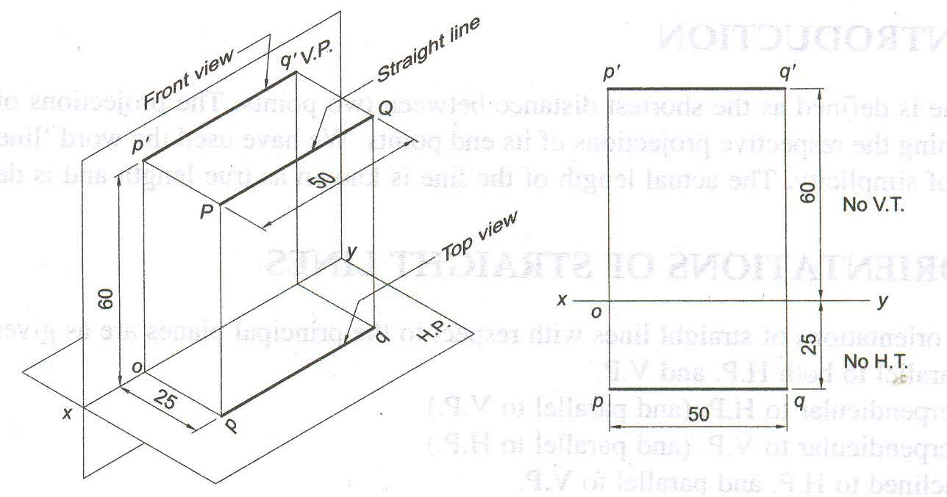
Line Parallel to both HP and VP and its traces

Slide 47
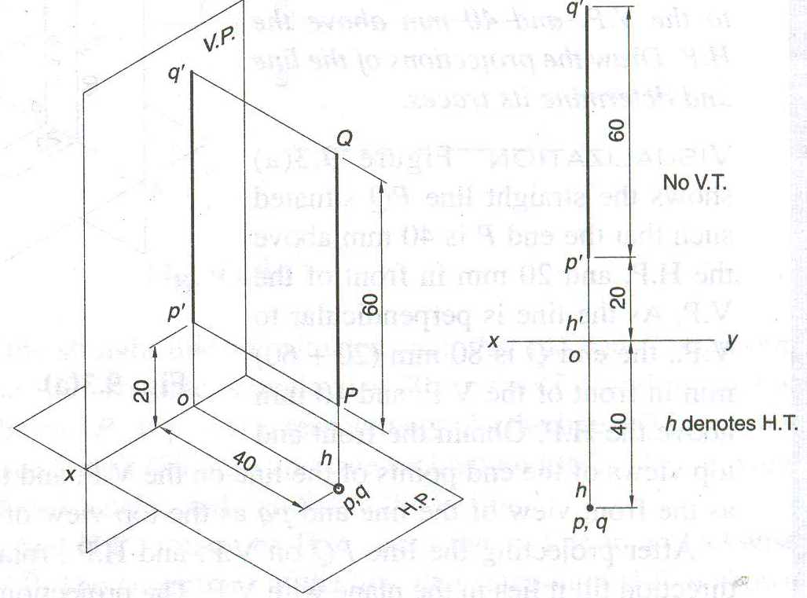
Line Parallel to VP and Perpendicular to HP and its traces

Slide 48
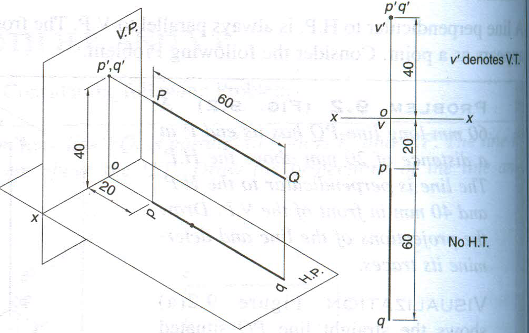
Line Parallel to HP and Perpendicular to VP and its traces

Slide 49
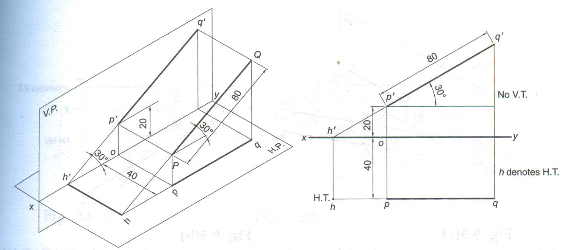
Line Parallel to VP and Inclined to HP and its traces

Slide 50
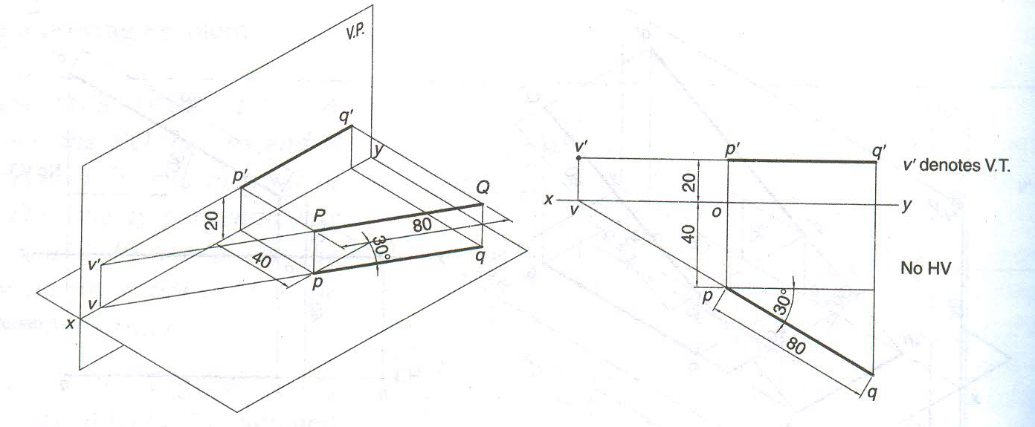
Line Parallel to HP and Inclined to VP and its traces
No HT

Slide 51
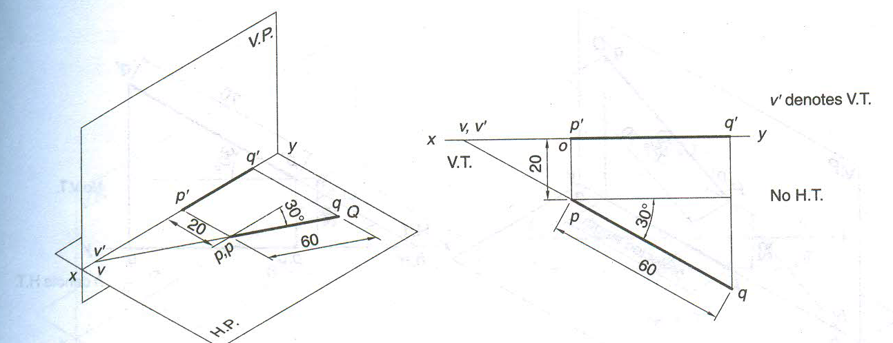
Line Lies on HP and Inclined to VP and its traces

Slide 52
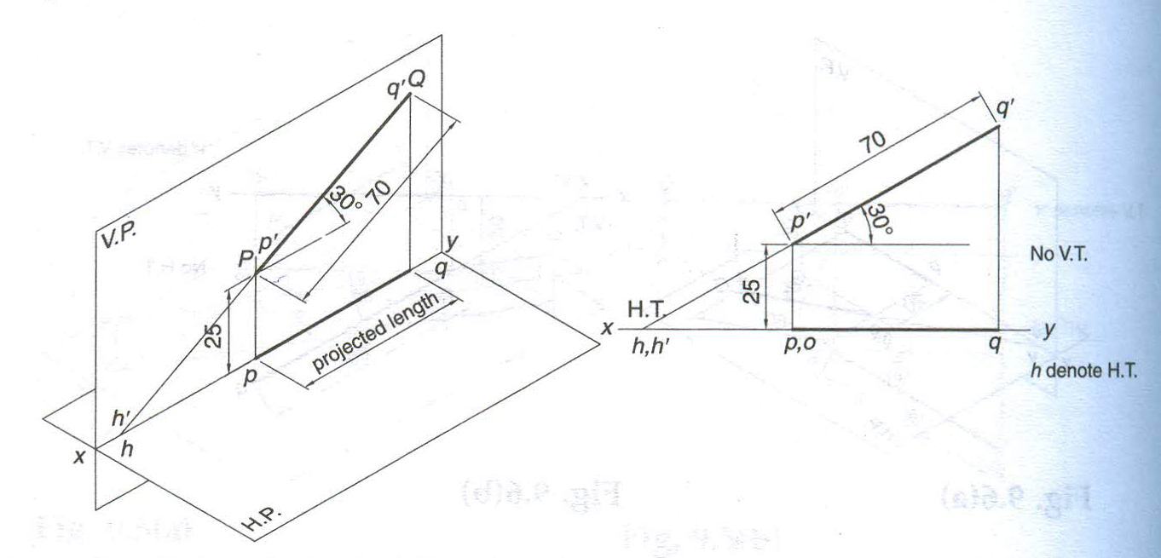
Line Lies on VP and Inclined to HP and its traces

Slide 53
b’
STEPS TO LOCATE HT
(WHEN PROJECTIONS ARE GIVEN)
FV
Begin with FV. Extend FV up to XY line.
Name this point h’
(as it is a FV of a point in HP)
3. Draw one projector from h’.
4. Now extend TV to meet this projector.
This point is HT
a’
x
v
h’
Y
VT
HT
a
STEPS TO LOCATE VT
(WHEN PROJECTIONS ARE GIVEN)
TV
Observe & note :-
1. Points h’ & v always on x-y line.
2. VT & v always on one projector.
3. HT & h’ always on one projector.
4. FV - h’- VT always co-linear.
5. TV - v - HT always co-linear.
Begin with TV. Extend TV up to XY line.
Name this point v
(as it is a TV of a point in VP)
3. Draw one projector from v.
4. Now extend FV to meet this projector.
This point is VT
b

Slide 54
VARIOUS ORIENTATIONS OF THE STRAIGHT LINES
Sl. No. | Orientation/ Position of line | Front view/ Elevation | Top view/ plan | Horizontal trace | Vertical trace
1 | Line parallel to both HP and VP | True length, parallel to xy | True length, parallel to xy | Does not exist | Does not exist
2 | Line perpendicular to HP | True length, perpendicular to xy | Point | Coincides with top view | Does not exist
3 | Line perpendicular to VP | Point | True length, perpendicular to xy | Does not exist | Coincides with front view
4 | Line inclined at Ɵ to HP and parallel to VP | True length inclined at Ɵ to xy | Shorter than the true length, parallel to xy | Exists | Does not exist
5 | Line inclined at Φ to VP and parallel to HP | Shorter than the true length, parallel to xy | True length inclined at Φ to xy | Does not exist | Exists
6 | Line situated in HP and inclined at Φ to VP | Shorter than the true length, lying on xy | True length inclined at Φ to xy | Does not exist | Exists on xy
7 | Line situated in VP and inclined at Ɵ | True length inclined at Ɵ to xy | Shorter than the true length, lying on xy | Exists on xy | Does not exist
8 | Line situated both in HP and VP | Both front and top views are true length and coincide on xy |  | Does not exist | Does not exist

Slide 55
Instead of considering a & a’ as projections of first point, if V & VT are considered as first point , then true inclinations of line with HP & VP i.e. angles θ & Φ can be constructed with points VT & V respectively.
b’
b₁’
FV
TL
Then from point v & HT
angles can be drawn.
&
From point VT & h’
angles can be drawn.
a’
β
&
Φ
V
h’
X
Φ
Y
α
&
θ
θ
VT
HT
THIS CONCEPT IS USED TO SOLVE
NEXT THREE PROBLEMS.
a
TL
TV
b
b₁

Slide 56
FINDING INCLINATION WITH HP & VP
PROBLEM 12 :- FV of line AB makes 45⁰ angle with XY line and measures 60 mm.
Line’s TV makes 30⁰ with XY line. End A is 15 mm above HP and it’s VT is 10 mm
below HP. Draw projections of line AB, determine inclinations with HP & VP and locate HT, VT.
SOLUTION STEPS:-
1. Draw XY line, one projector and
locate FV (a’) 15 mm above XY.
2. Take 45⁰ angle from a’ and
marking 60 mm on it locate point b’.
3. Draw locus of VT, 10 mm below XY & extending FV to this locus locate VT, as FV-h’-VT’ lie on one straight line.
4. Draw projector from VT’, locate
V on XY.
5. From V take 30⁰ angle downward as TV and it’s inclination can begin with v. We get point a.
6. Draw projector from b’ and locate b, i.e., TV point.
7. Draw a projector from h’ below it, locate HT.
8. Draw locus of a, b, b’
9. With ab as radius draw an arc to locus of a and extend it upto b’₁. Join a’ b’₁. We get Ɵ
10. Similarly find with a’b’ as radius.
b’
b’₁
a’
45⁰
θ
x
15
v
h’
Y
10
30⁰
HT
VT
a
∅
b
b₁
∅

Slide 57
FINDING TL WITH IT’S INCLINATION WITH HP & VP
PROBLEM: One end of line AB is 10mm above HP and other end is 100 mm in-front of VP.
It’s FV is 45⁰ inclined to XY while it’s HT & VT are 45mm and 30 mm below XY respectively.
Draw projections and find TL with it’s inclinations with HP & VP.
b’
b’₁
LOCUS OF b’ & b’₁
SOLUTION STEPS:-
1. Draw XY line, one projector and locate a’ 10 mm above XY.
2. Draw locus 100 mm below XY for points b & b₁
3. Draw loci for VT and HT, 30 mm & 45 mm below XY respectively.
4. Take 45⁰ angle from a’ and extend that line backward
to locate h’ and VT. Locate v on XY above VT. Locate HT below h’ as shown.
5. Then join v – HT and extend to get top view end b.
6.Draw projector upward and locate b’. Make ab & a’b’ dark.
7. Now as usual rotating views find TL and it’s inclinations.
FV
TL
a’
45⁰
X
10
v
h’
Y
30
45
VT
HT
100
a
Φ
TL
TV
b
b₁
LOCUS OF b & b₁

Slide 58
LOCATING TRACES, FINDING TL AND INCLINATIONS
PROBLEM: Projectors drawn from HT and VT of a line AB are 80 mm apart and those drawn from it’s ends are 50 mm apart. End A is 10 mm above HP, HT is 35 mm below XY while it’s VT is 55 mm above XY. Draw projections, locate traces and find TL of line & inclinations with HP and VP.
VT
SOLUTION STEPS:-
1.Draw XY line and two projectors, 80 mm apart and locate HT & VT, 35 mm below XY and 55 mm above XY respectively on these projectors.
2.Locate h’ and v on XY as usual.
3.Now just like previous two problems, extending certain lines complete FV & TV, and as usual find TL and it’s inclinations.
b’
b’₁
FV
55
TL
Locus of a’
a’
θ
X
10
50
v
Y
h’
b
b ₁
TV
35
TL
a
Φ
HT
80

Slide 59

Thank You for Patient Hearing

